Slide 1
Instrument Recognition Through Machine Learning

Slide 2
Problem Statement
Implement and compare methods of machine learning in identifying an instrument being played during a monophonic audio track.

Slide 3
1. Dataset
NSynth Dataset

Slide 4
NSynth Dataset Overview
A large-scale and dataset of annotated musical notes containing 305,979 musical notes from 1,006 instruments
01
Train
289,205 samples
02
Verification
12,678 samples
Instruments do not overlap with train.
03
Test
4,096 samples
Instruments do not overlap with train.

Slide 5
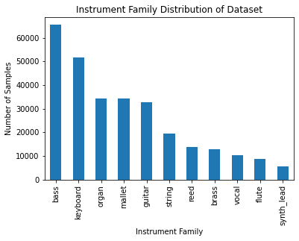
Instrument | Sample Number
bass | 65474
keyboard | 51821
organ | 34477
mallet | 34201
guitar | 32690
string | 19474
reed | 13911
brass | 12675
vocal | 10208
flute | 8773
Synth_lead | 5501
Training dataset distribution

Slide 6
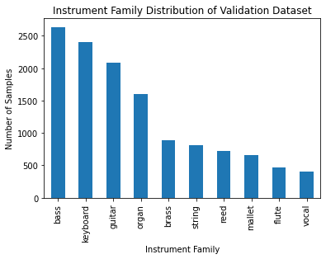
“Initial” data
Taken from the validation dataset
4,000 audio samples in total
400 of each instrument
Test size of 0.25
1,000 test
3,000 train

Slide 7
“Full” data
Taken from the train dataset
10,000 audio samples in total
1,000 of each instrument
Test size of 0.1, Validation size of 0.09
1,000 test
900 validation
8,100 train

Slide 8
3. Audio features
Feature usage

Slide 9
Main Features
Mel Spectrogram
A spectrogram is an intensity plot of the Short-Time Fourier Transform (STFT) magnitude. The mel spectrogram frequencies are converted to the mel scale where pitches judged by listeners to be equal in distance one from another are represented as such.
MFCC
(Mel-Frequency Cepstral Coefficient )
MFC is found by spacing the frequency bands of the spectrum of a signal equally along the mel scale, and then taking the FT logarithm of the spectrum. The coefficients of this transformation represent the power spectrum of the signal
Spectral Contrast
An interpretation of the signal’s spectrogram. The spectral contrast considers the spectral peaks and the spectral valleys, and finds the difference in each frequency subband.

Slide 10
Additional Features Considered
Harmonic/Percussive
Chroma
Spectral contrast
Spectral rolloff
Spectral centroid
Zero-cross rating

Slide 11
Model feature | Accuracy
Mfcc | 89.90%
Spectral Contrast | 87.30%
Spectrogram | 82.30%
Chroma | 56.80%
Spectral Centroid | 28.70%
Zero-cross Rating | 27.90%
Spectral Rolloff | 27.10%
Harmonic/Percussive | 13.70%
Evaluating Feature sensitivity

Slide 12
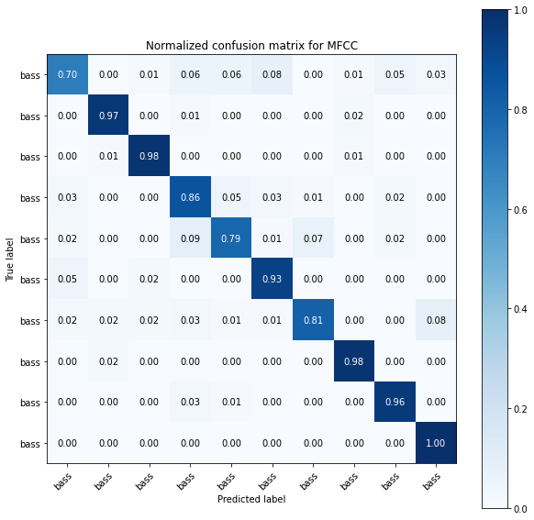
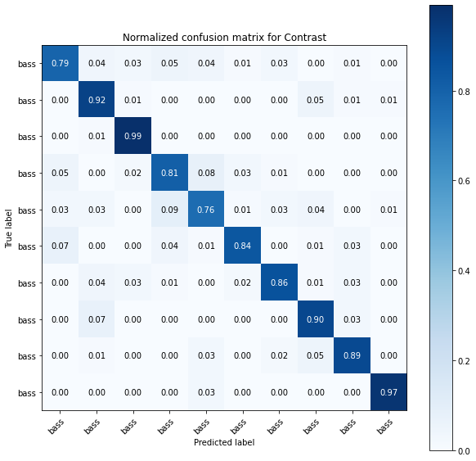
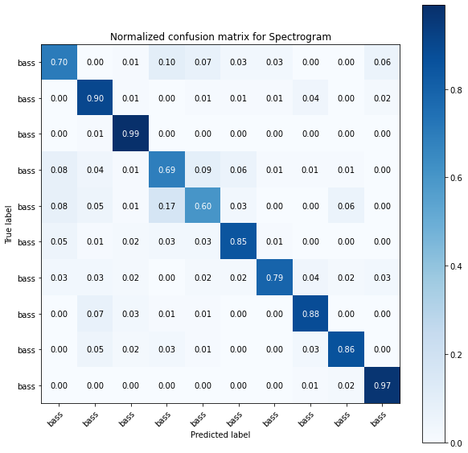
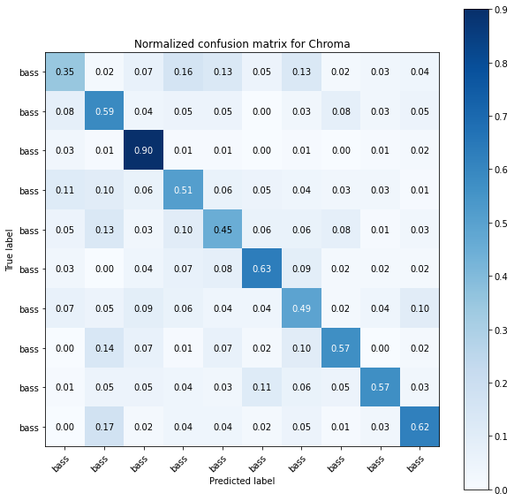
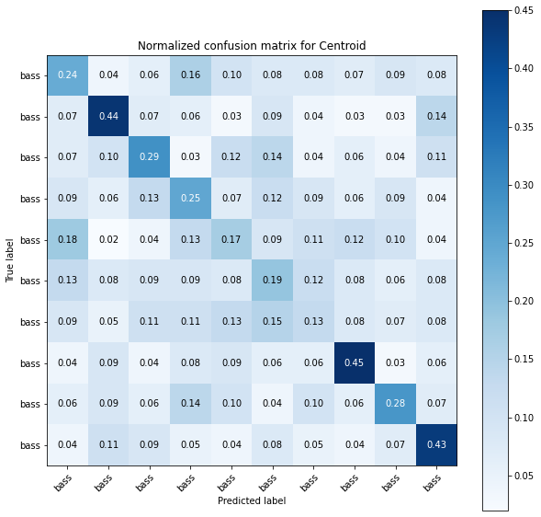
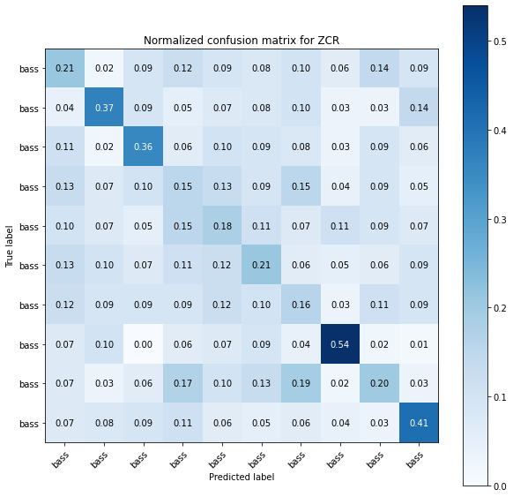
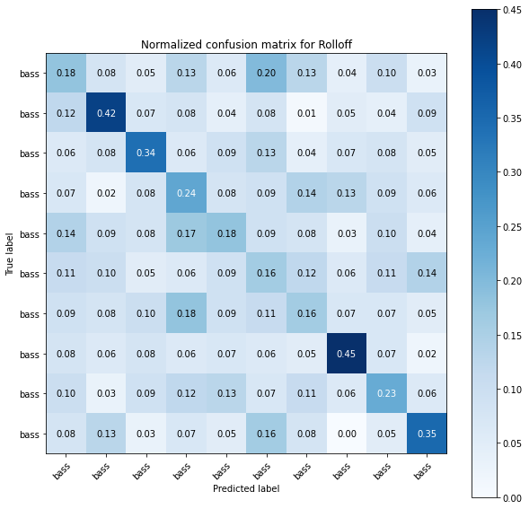
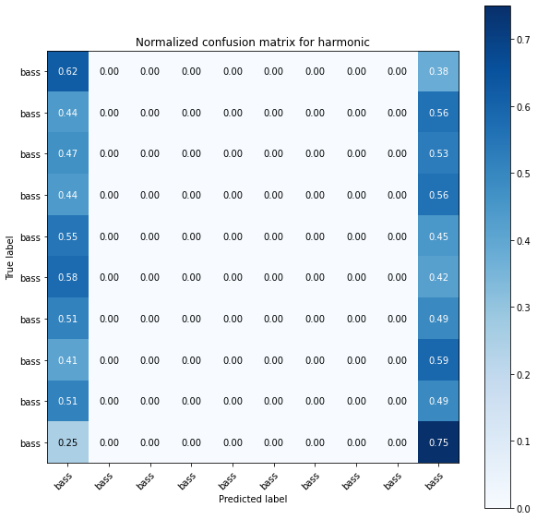

Slide 13
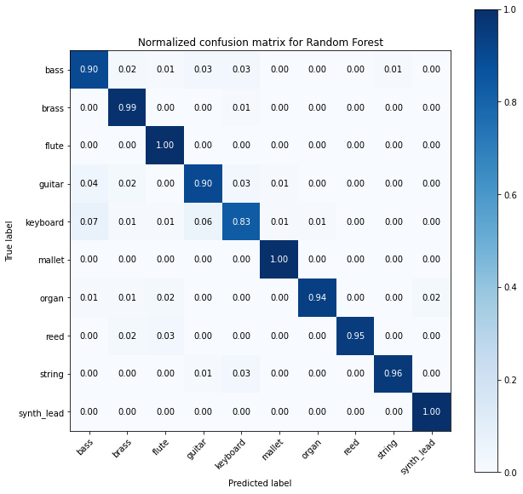
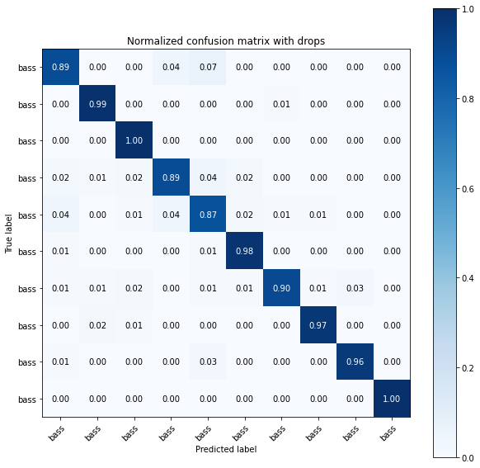
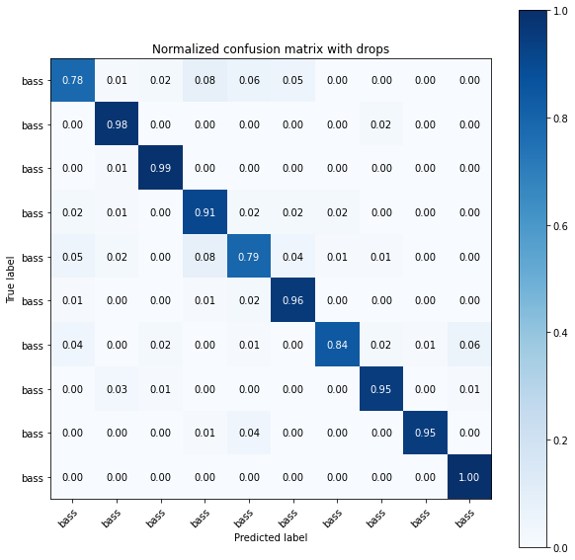
All features
Accuracy: 94.70%
MFCC
Contrast
Spectrogram
Accuracy: 94.50%
MFCC
Contrast
91.50%

Slide 14
Feature Extraction Implemented
MFCC, Contrast, Spectrogram were implemented.
These provided 12, 7, and 128 coefficients per sample respectively.
147 “points of data” per sample

Slide 15
3. Random Forest Model
“Shallow” learning

Slide 16

Random Forest Model
An ensemble learning method for classification that utilizes a multitude of decision trees to train the model and outputs the class that is the mode of the classes
Decision tree is a predictive modelling approaches used in statistics, data mining and machine learning.

Slide 17
Using initial data:
accuracy: 0. 9450
Precision: 0.941
Recall:0.941
f1-score: 0.942

Slide 18
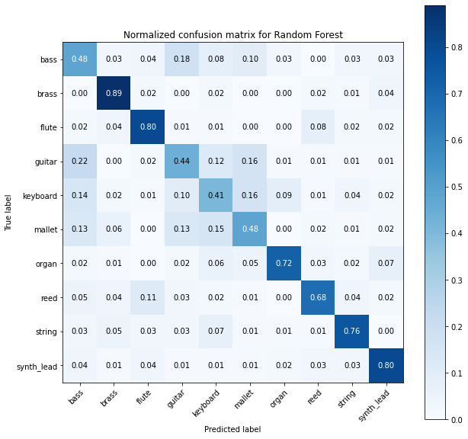
Using full set:
accuracy: 0.6460

Slide 19
4. LSTM Model
Deep learning

Slide 20
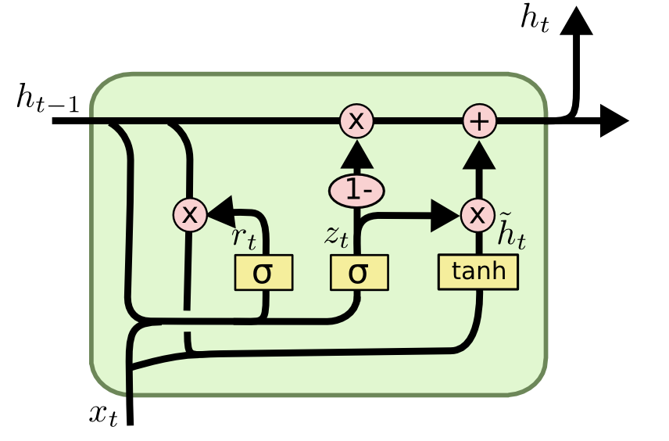
Long short-term memory
Long Short Term Memory networks (LSTMs) are a kind of RNN that are capable of learning long-term dependencies
Has input gate, an output gate and a forget gate
remembers values over arbitrary time intervals and the three gates regulate the flow of information into and out of the cell.

Slide 21
LSTM Implementation
Audio Database
LSTM
LSTM
Density
(relu)
Density
(Softmax)
Detected Instrument
Dropout:
0.2
Dropout:
0.2
Dropout:
0.3

Slide 22
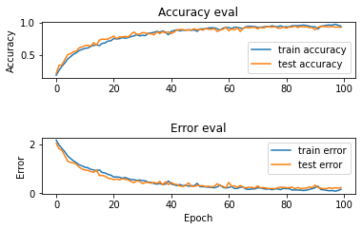
Parameters
Batch size = 32
Epochs=100
3,240 Train samples
→ 102 batches per cycles
Train accuracy:
0.936
Train loss:
0.214

Slide 23
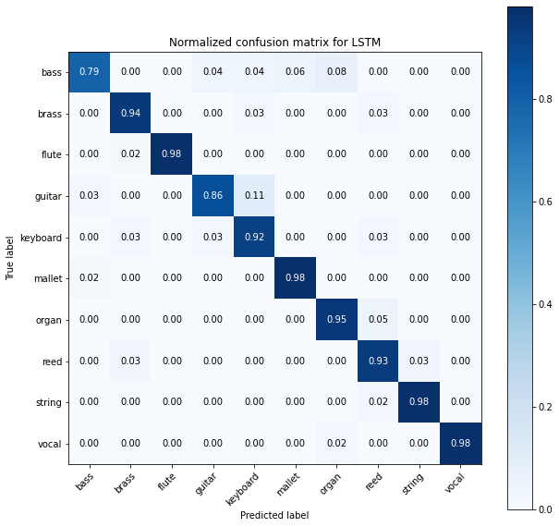
Using initial set:
accuracy: 0.9275
loss: 0.2275
Precision: 0.924
Recall:0.931
f1-score: 0.971

Slide 24
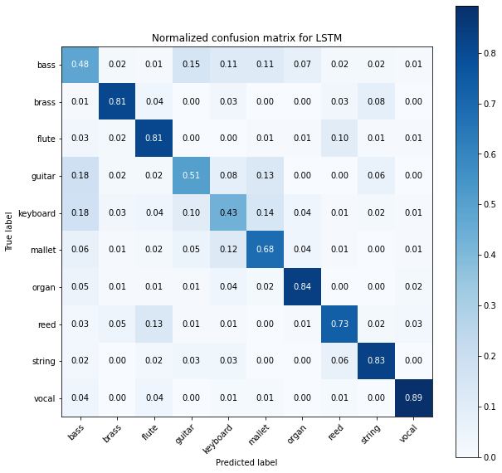
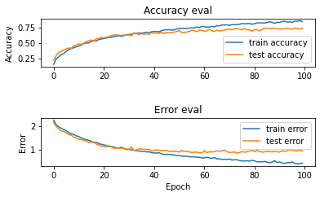
Using full set:
accuracy: 0.6980
loss: 1.0833

Slide 25
4. Discussion
Error analysis and future results

Slide 26
Results Summary
Dataset | “Validation” Set | “Test” Set
Random Forest Metrics (Accuracy) | 0. 9450 | 0.6460
LSTM Metrics (Accuracy/Loss) | 0.9275/ 0.2275 | 0.6980/1.0833

Slide 27
Analysis and Discussion Cont.
In practice both RF and LSTM performed about the same
RF performed better with less data
LSTM performed better with more data
Inputs to the RF and LSTM models were identical
Relative performance may have been skew by preprocessing
There may be faulty samples within dataset, possibly silent, poorly recorded, or corrupted during conversion.
Train set was too large to do quality check

Slide 28
Error Analysis
There may be faulty samples within dataset, possibly silent, poorly recorded, or corrupted during conversion
Train set was too large to do fine grain quality check
Model hyperparameters where manually tuned
could have benefited from a automated tuning process like Grid search

Slide 29
Error Analysis Cont.
Specific instruments seem to be commonly confused with one another
This pattern is true of both the RF and LSTM models
More data usage or separately built and ensembled models may have helped

Slide 30
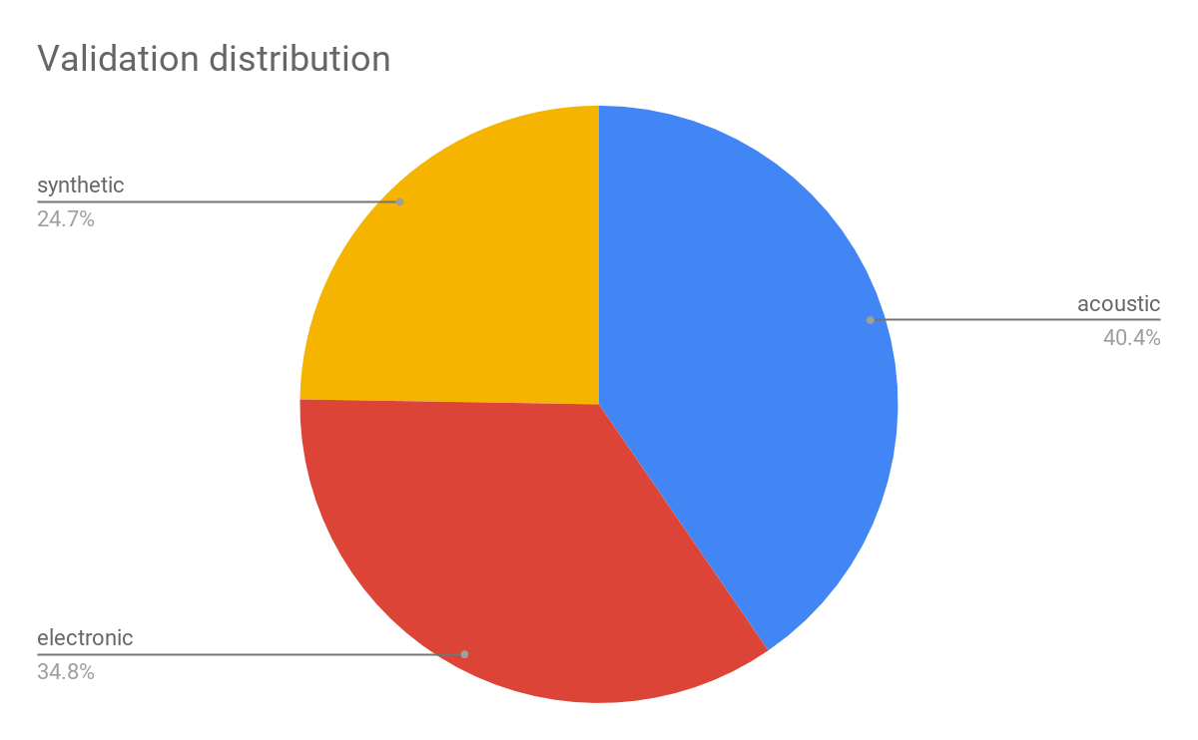
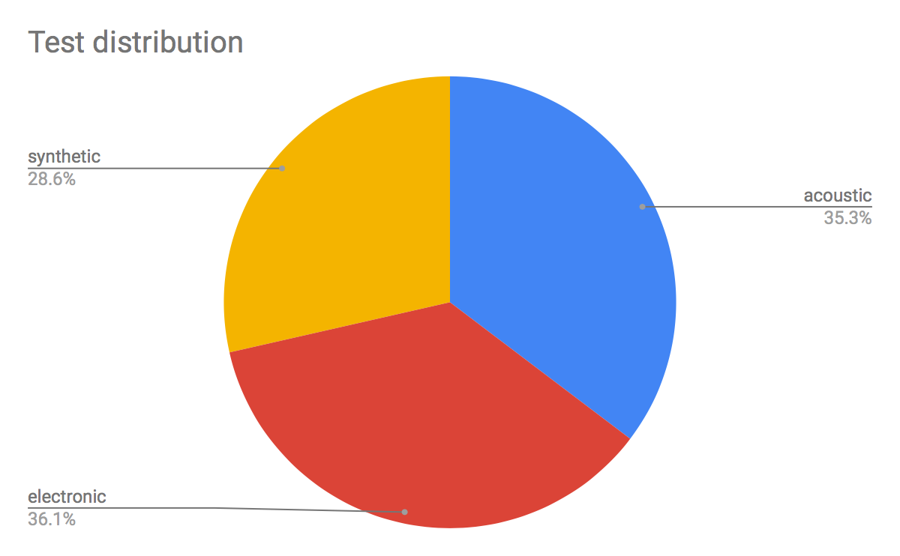
Error Analysis Cont.
Although the training dataset was significantly larger than the validation dataset, the performance of the model decreased.
Internal biases within the dataset
Source distribution differences

Slide 31
Thanks!
Any questions?

